Slide 1
Answer to Ex 5.1
Consider a MIN node whose children are terminal nodes. If MIN plays suboptimally, then the value of the node is greater than or equal to the value it would have if MIN played optimally. Hence, the value of the MAX node that is the MIN node’s parent can only be increased. This argument can be extended by a simple induction all the way to the root.

Slide 2
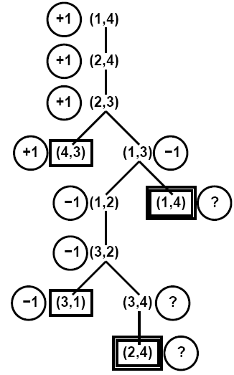
Game Tree for Ex 5.2
Think about how to get the values

Slide 3
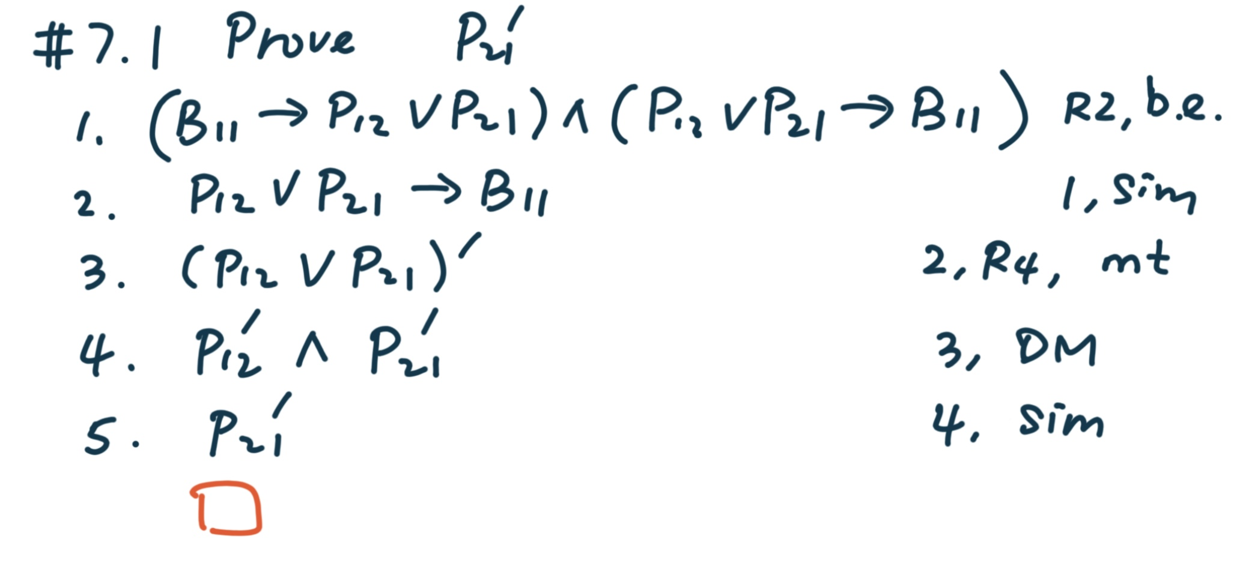
#7.1

Slide 4
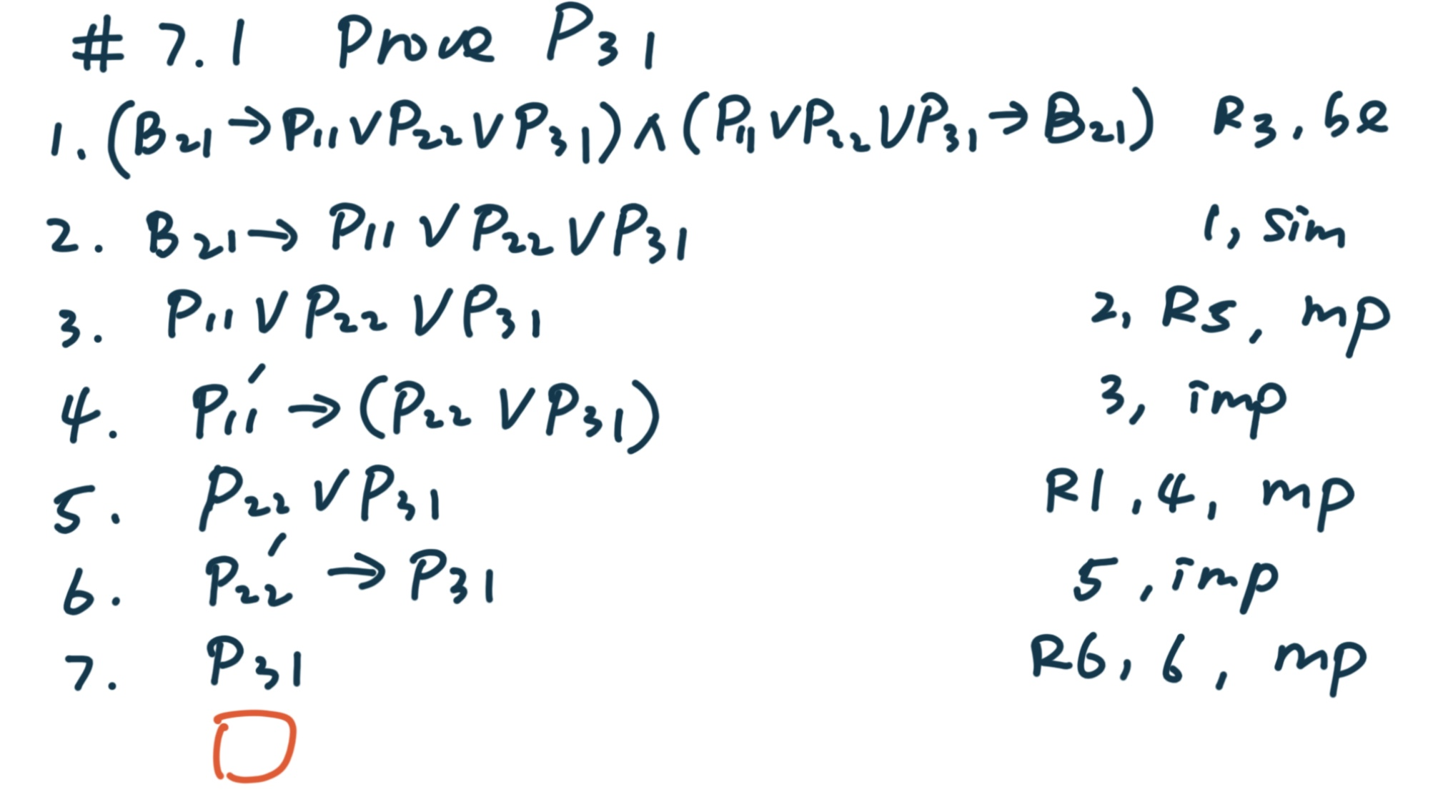
#7.1

